Slide 1
WEB 322 WEB PROGRAMMING TOOLS AND FRAMEWORKS
Week 8 - Lecture 1
Databases, PostgreSQL and Sequelize

Slide 2
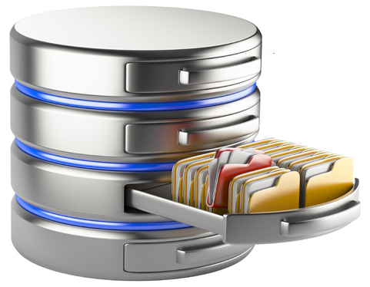
What is a Database?
An organized collection of data.
Generally stored and accessed electronically from a computer or computing device.
The goal of using a database is to persist data and make it easily accessible.
Operations performed on a database: CRUD
Create
Read
Update
Delete
Provides quicker access than a file or traditional ways of storing data.

Slide 3






Types of Database Engines
Relational (or SQL Databases)
MySQL
Oracle
SQL Server
PostgreSQL
NoSQL Databases
MongoDB
Firebase
Cassandra

Slide 4

Relational (SQL) Database - Overview
Store data in objects called tables.
Each table usually stores data about a particular “thing”.
Examples:
An employee table will store data about employees.
A products table will store data about products.
Each table contains columns.
Data is placed into the fields forming rows (or records).

Slide 5
Relational (SQL) Database - Characteristics
Tables can have form relationships with other tables.
In other words, tables are connected to each other.
Helps keep your data normalized (or organized).
Reduces data redundancy.
Databases have a predefined data schemas. For each table, we define:
What data should be stored in the table.
How the data will be formatted (data types used).
(Standardized) SQL queries and commands are used to interact with the database.

Slide 6
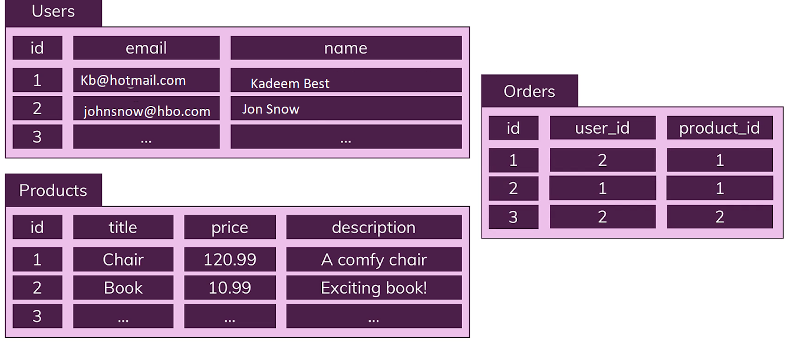
Relational (SQL) Database - Example

Slide 7
NoSQL Database - Overview
Do not follow the same approach as Relational or SQL databases.
It uses its own query language. SQL is not used with NoSQL databases.
Data is stored in entities called collections.
Inside a collection, you will find documents, not rows or records.
Documents:
Describe data very similar to JavaScript.
Look like JavaScript objects.

Slide 8
NoSQL Database - Document Characteristics
Documents are considered “schema-less”(no structured required).
They are more flexible than Relational database tables.
Each document can store data with different attributes.
Documents mirror a JavaScript object literal and therefore documents represent data in the same way that applications do.
Unlike the tabular rows and columns of a relational database, data can be structured with arrays and subdocuments.
There are usually no (or very few) relations.
Documents can potentially make applications fast.
Data for an entity is stored in a single document rather than spread across multiple relational tables so the database only needs to read and write to a single place.
Having all the data for an object in one place also makes it easier for developers to understand and optimize query performance.

Slide 9
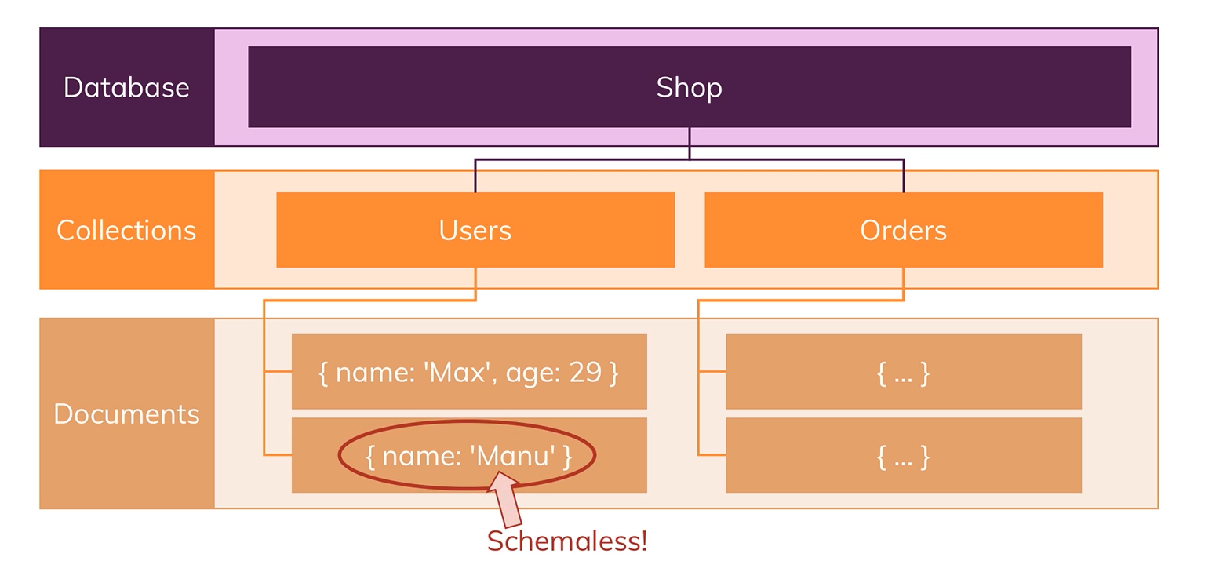
NoSQL Database - Example

Slide 10
Relational (SQL) vs NoSQL Databases
Relational (SQL) | NoSQL
Data uses schemas. | Schema-less.
Uses relationships. | No (or very few) relationships.
Data is distributed across multiple tables. | Data is typically merged/nested in a few collections.
Costly for lots of read and write queries per second. | Great performance for mass read and write requests.

Slide 11
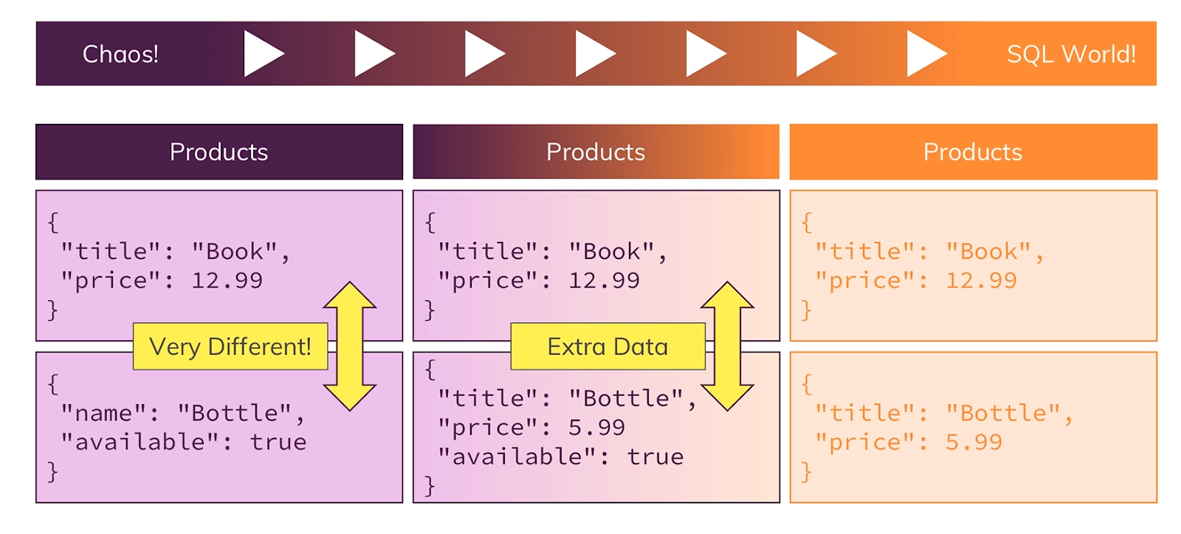
To Schema … or … Not to Schema
The case in the middle is what you will usually see in the real world.
It is a blend between the two scenarios.

Slide 12
How to Communicate with a Database
Typical ways to communicate to a database in your application.
A query language.
For example, Structured Query Language (SQL).
An Object Relational Mapper (ORM)
ORMs are specifically used for Relational and SQL databases.
For example, Sequelize (https://sequelize.org)
An Object Document Mapper (ODM)
ODMs are specifically used for NoSQL databases.
For example, Mongoose (https://mongoosejs.com)

Slide 13


Slide 14
PostgreSQL Overview
Also known as “Postgres”
Open-source relational database engine.
More than 15 years of active development.
Full support for foreign keys, joins, views, triggers and stored procedures.
Data types include INTEGER, NUMERIC, BOOLEAN, CHAR, VARCHAR, DATE, INTERVAL and TIMESTAMP.
Admin tools, download from: https://www.pgadmin.org/download

Slide 15


Slide 16
Sequelize - Overview
An ORM for relational databases like Postgres, MySQL, and SQL Server.
It maps our JavaScript objects to tables and rows within the database.
Automatically creates SQL commands on the fly.
Allows relational support, transaction support, eager and lazy loading.

Slide 17
Sequelize - Data Types
STRING: A variable length string. Default length 255
TEXT: An unlimited length text column.
INTEGER: A 32-bit integer.
FLOAT: Floating point number (4-byte precision).
DOUBLE: Floating point number (8-byte precision)
DATE: A datetime column
TIME: A time column
BOOLEAN: A Boolean (yes/no) column

Slide 18
Sequelize - Table Creation
// Define our “User” and “Task” models (tables)
var User = sequelize.define('User', {
fullName: Sequelize.STRING, // The user's full name (ie: "Jason Bourne")
title: Sequelize.STRING // The user's title within the project (ie, developer)
});
var Task = sequelize.define('Task', {
title: Sequelize.STRING, // The title of the task
description: Sequelize.TEXT // The main text for the task
});
// Associate Tasks with user & automatically create a foreign key
// relationship on “Task” via an automatically generated “UserId” field
User.hasMany(Task);

Slide 19
Sequelize – CRUD Operations
Create:
model.create({ … })
Read:
model.findAll({
attributes: [ … ],
where: { … },
order: [ … ]
})

Slide 20
Sequelize – CRUD Operations
Update:
model.update(
{ … },
{ where: { … } }
)
Delete:
Model.destroy( { where: { … } } )

Slide 21
Sequelize - Installation
To use Sequelize in your Node/Express app:
Install the package: npm install sequelize
Install the package: npm install pg pg-hstore
Import (require) the package: require(‘sequelize’)
Connect to and use the database.
See the official documentation: https://sequelize.org/master

Slide 22

Live Demo
Create a PostgreSQL instance
Add resource to Heroku app.
Obtain connection information.
pgAdmin
Connect to and explore a PostgreSQL database.
Express App
Create a quick express app.
Create a model to use with PostgreSQL.
Perform CRUD operations on the database using Node.js.

